Slide 1

Flipkart Customer Segmentation and Targeted Marketing Intelligence
Ajayraj R
BMAI-S-WD-T-B32
Final Project - 1

Slide 2
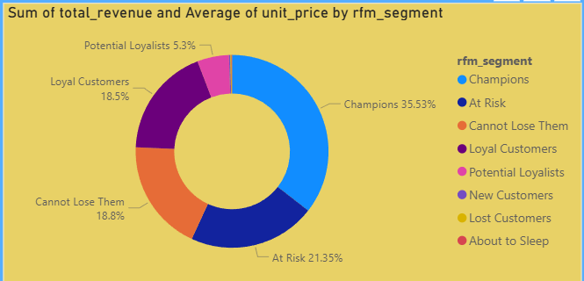
Revenue Share by each segment

Slide 3
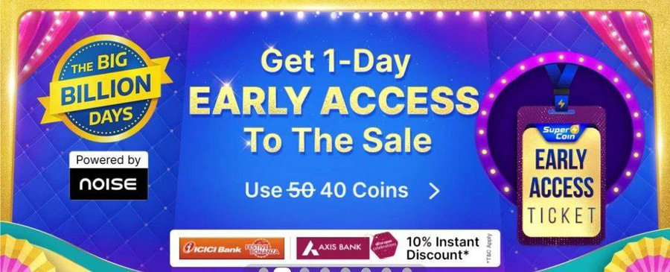
Champions
Analysis
These are the most valuable set of customers to any business.it is very important that a healthy amount of marketing spending can be incurred here to keep them engaged with our product or service.
They contribute the highest in terms of revenue which is 35.5%.
They respond well to loyalty points 67% open rate.
Recommendations
We can give them priority treatment to make them stay loyal.
Flipkart gives early access to the priority customers for offer products. These can be used for them.

Slide 4
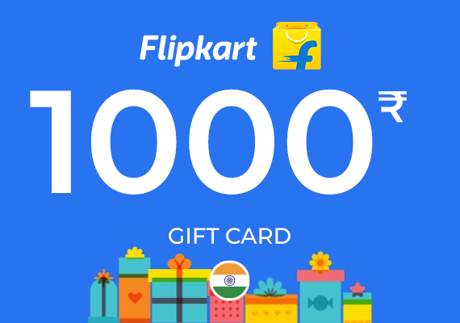
Potential Loyalists
Analysis
This is potentially the largest group in terms of customer counts wiz 1400+
But in terms of contribution they do not pose a lot. They purchase good quantity of items but that does not translate to revenue as much as we would expect.
This high count and low value suggests that they stick to categories that does not cost a lump sum.
Recommendations
Voucher or coupons could be provided so that order value may increase and push them to higher average order value

Slide 5
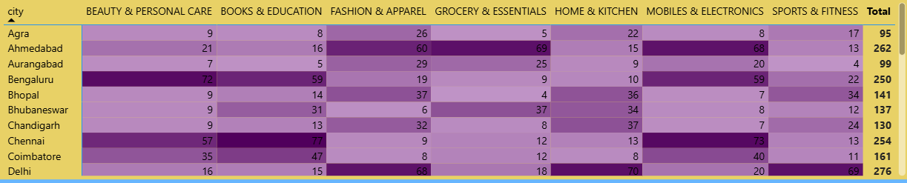
Product and category Intelligence

Slide 6
At Risk
Analysis
They are a massive revenue barrier and deliberately larger customer base.
Evidently they have higher click rates on “welcome discounts”(66%) but their “bug billion days “ engagement is not much in numbers.
They contribute significantly to the revenue unlike potential loyalists so losing them would be a crucial loss.
Recommendations
A limited time offer of 20% -25% of their most browsed items may encourage them. Mostly consists of “Fashion” or “Mobiles” category as per the session’s heatmap

Slide 7
Cannot lose them
Analysis
They contribute 18% of revenue in spite of being a relatively small customer numbers. They have a really high “cart abandonment” response referring to their 60% of click rate.
Their “cart abandonment” shows they are likely to buy or still looking. These were likely big spenders who stopped purchasing.
Recommendations
Offering a loyalty points renewal system for them is effective.
Priority delivery benefits can also attract them.

Slide 8
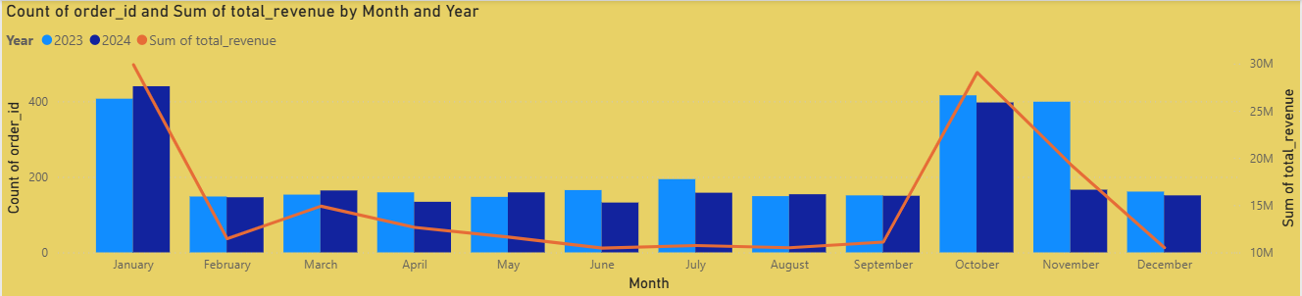
Average Order value by Month

Slide 9
New Customers
Analysis
These are relatively fresh customers and they show strong engagement in “Mobiles and Electronics” category. Their conversion rates on “welcome Discounts” are significantly good.
As these users newly joined the system, the goal now would be to move them towards a second purchase to technically prevent them from going down to “lost category.
Recommendations
Welcome discounts can be encouraged, or First Order offers are also recommended.
Cross sell offers were when they purchase mobiles , accessories can be given with discount or for free for the first time. Also since their most participated category is “Mobiles and Electronics”.

Slide 10
Loyal customers
Analysis
They contribute around 18.5 % of our total revenue. Referring to the campaign heatmap, they have a very high response to the “loyalty Points Bonus” (56%) open rate.
These customers are generally consistent throughout. Using “gamification” to keep them engaged since they already have a general trust in the brand.
Recommendations
Since they would ultimately possess points, we can make a campaign where they could shop and double those points – point multiplier system campaign.
When they also have large loyalty points it means that they can be attracted towards refer a friend campaigns as well.

Slide 11
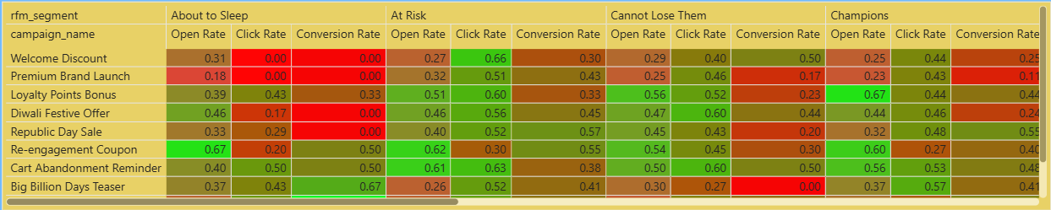
Campaign performance by Segment

Slide 12
About to sleep
Analysis
This group has a surprisingly high open rate of 67% on the re-engagement coupons, but their conversion rate on the campaign is jus 50%.
They do check out their push notifications and emails but still need a better reason to make a purchase.
Checking the notifications mean that they are aware of the brand . Data also shows that they spend sessions in “home & kitchen” and “Fashion”.
Recommendations
Flash sale notification may attract them to make purchases.
Such limited period deals may convince them to convert

Slide 13
Lost customers
Analysis
This is the smallest revenue contributor out of all the segments and has the lowest engagement rate throughout.
But still they too showed 67% conversion rate on the “big billion days” season.
They could be attracted during major events like “big billion days”. It could pull them back in.
Recommendations
They can be targeted via a umbrella while big festive sales are coming up.
Welcome-Back offers may also prove to be significant.

Slide 14
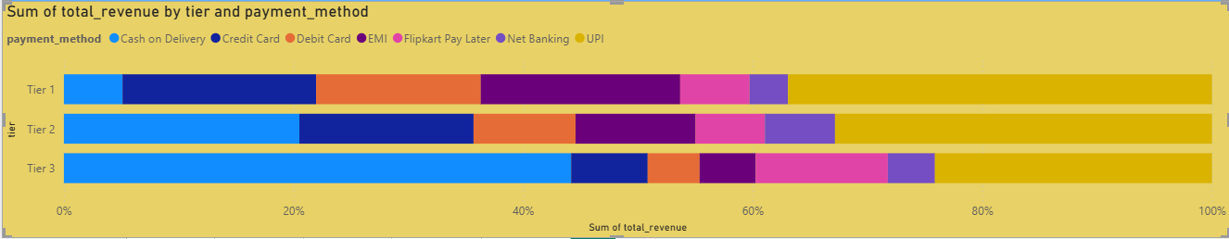
Payment method split by Tier

Slide 15
Recommendations – General
As per the payment method trends tier 3 cities rely largely on COD. So marketing campaigns could highlight the Presence of COD for those places as a important feature.
Revenue hits peak at January and October, so marketing should look to attract maximum transactions during these seasons.
The category of “Books and education” is to be focused more as it has the lead in volume mainly via potential loyalists. Since potential loyalists are the largest in number this puts it as a priority.
The revenue heats an all time low during February and September. Those gaps should also be bridged with the help of marketing campaigns.

Slide 16
Thank you

